Slide 1
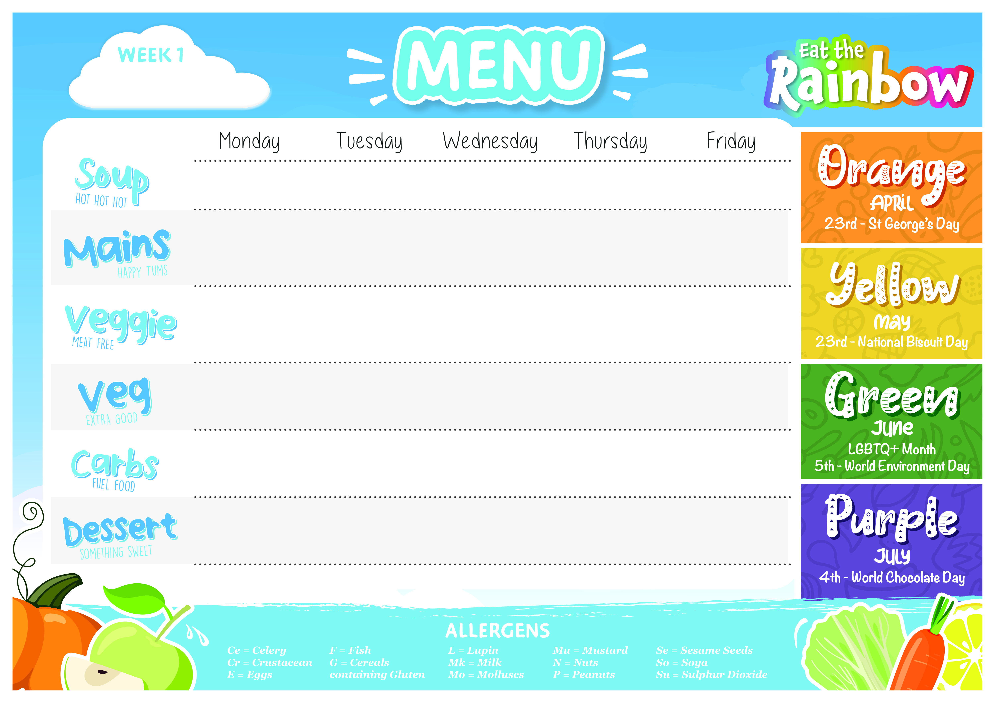
15TH April, 6th May, 3rd June, 24th June
Two mushroom velouté (G,Mk) | Vegan watercress and potato | Curried parsnip (Mu,Ce) | Vegan Italian bean soup (Mu,Ce) | Cream of celeriac soup (Ce,Mk)
Veggie chilli con carne, crushed nachos and sour cream (So,Mk) | Italian beef Lasagne (G,E,Mk) | Roast chicken breast and sage and onion stuffing (G) | Cowboy Pie (G,Su) | Fish Fingers, tartare sauce and lemon (F,G,E)
Spicy vegetable tacos sour cream, grated cheese (G,Mk) | Veggie lentil bolognaise, penne pasta and parmesan (G,Mk) | Cream cheese, red onion and spinach pasta bake (G,Mk) | Veggie Cowboy pie (G) | Vegetable spring rolls with sweet chilli and coriander sauce (G,So)
Rainbow slaw (E) Mixed leaves | Tomato and red onion salad | Roasted carrots Cabbage | Cauliflower Green beans | Garden peas Baked beans
Mexican tomato rice (Ce) | Focaccia fingers (G) | Roast potatoes | Crushed new potato | Baked oven chips
Steamed chocolate chip pudding with chocolate sauce (G,E,Mk,So) | Eccles cake tray bake with cream (Su,So,Se,Mk,L,G) | Lemon and poppy seed pudding (G,E,Mk) | Pear Streusel Cake (G,E,Mk) | Raspberry Granola Bar with yoghurt topping (G,Mk)
Jacket Potatoes, Tomato Pasta, salad bar and fresh fruit available daily.

Slide 2

22nd April, 13th May,
10th June, 1st July
Carrot and coriander (G) | Butternut squash | Cream of leek and potato (Mk) | Broccoli and stilton (Mk) | Vegan French onion soup (G)
Margherita pizza (G,E,Mk) | Beef mince enchilada pie (G,Mk) | Sausage plait (G,Su) | Chicken pasta bake (G,Mk) | Fish fingers tartare sauce and lemon wedges (G,F,E)
Roasted vegetable Pizza (G,E,Mk) | Layered roasted vegetable, tomato enchilada pie (G,Mk) | Sweet potato feta & spinach puff pastry pie (G,Mk) | Macaroni, creamy cheese and leek crumble (G,Mk) | Oven baked gnocchi with tomato, mozzarella & pesto, with garlic bread (G,So,Mu,Mk,E)
Panzanella salad (G,So) | Guacamole Pickled red cabbage (Su) | Curly kale Roasted carrots | Chefs salad | Garden peas Baked beans
 | Potato wedges | Thyme roast potatoes | Garlic bread (G,Mk,So) | Baked oven chips
Orchard crumble with custard (G,Mk) | Steamed strawberry jam sponge pudding (G,E,Mk,Su) | Italian tiramisu (G,E,Mk,So) | Apple and cinnamon pie with shortcrust pastry and custard (G,Mk) | Baked banoffee cheesecake (G,Mk)
Jacket potatoes, Tomato pasta, salad bar and fresh fruit available daily.

Slide 3

29th April, 13th May,
17th June, 8th July
Vegan tomato chipotle & rice soup | Cauliflower and cheddar (Mk) | Moroccan carrot & ginger | Vegan chunky vegetable | Chickpea and tomato
Beef meatballs served in a tomato sauce with penne pasta (G,Su) | Cottage pie (Ce) | Pork butchers’ sausages with gravy (G,Su) | Chicken korma (Mu,Ce) | Beef burgers (G,Su,Se)
Veggie meatballs served in a tomato sauce with Penne pasta (G,So) | Vegan puy lentil shepherd's pie with sweet potato (G,Ce) | Vegetarian sausages (G) | Vegetable korma curry (Mu,Ce) | Vegan chick pea and corn burger with a mango and lime salsa (G,Se)
Chefs mixed salad | Steamed broccoli Roasted carrots | Green beans Roasted tomatoes | Mango chutney | Garden peas Baked beans
Garlic bread (G,Mk,So) |  | Mashed Potato | Steamed rice Naan bread (G,Mk) | Baked oven chips
Roasted pineapple and ginger cake (G,Mk,E) | Blueberry buttermilk Loaf (G,Mk,E) | Sticky toffee pudding with toffee sauce (G,E,Mk,Su) | Banana and chocolate crumble with custard (G,Mk) | Blueberry mess (Mk,E)
Jacket potatoes, Tomato pasta, salad bar and fresh fruit available daily.

